Slide 1
Movie Recommendation System
Mini Project
Name: Aditya Rajendra Naranware
Reg No: 206301102
Subject: Machine Learning
Class: CSE (VIth Sem)

Slide 2
Problem Statement
Aim: Build a movie recommendation system based on ‘MovieLens’ dataset.
We wish to integrate the aspects of personalization of user with the overall features of movie such as genre, popularity etc.
Notes:
Implemented popularity model, content based model, collaborative filtering model and latent factor based model and combining the above to form a hybrid model.
Hyperparameter tuning, testing accuracy and evaluation of recommendations of each model

Slide 3
DataSet
MovieLens review dataset (ml-latest-small)
Ratings: 100k
Movies: 9k
Users: 600
Integrated the dataset with IMDB and TMDB data set publically available.
Split the dataset into 80% training and 20% testing based on the User ID.
Notes:
The primary dataset used for this project is the movielens review dataset. consisting of 27,753,444 reviews over 58,098 different movies by 283,228 users.

Slide 4
Feachers
Netflix and Disney, for example, rely heavily on the effectivencesss of their recommendation engines to drive their growth and success.
I feel that recommendation systems would have a significant influence on application access and usage, and it is critical that the user maintains interest in the application.
We need to disply people trending information of stuff that they could enjoy in order to keep them interested in our project.

Slide 5
Models
Popularity based model
Content based model
Collaborative Filtering
Matrix Factorization method
Hybrid model
Prediction

Slide 6
Content-Based Recommendation
User profile based on item profiles
Genre
Year of release of movie
Movie - Movie similarity

Slide 7
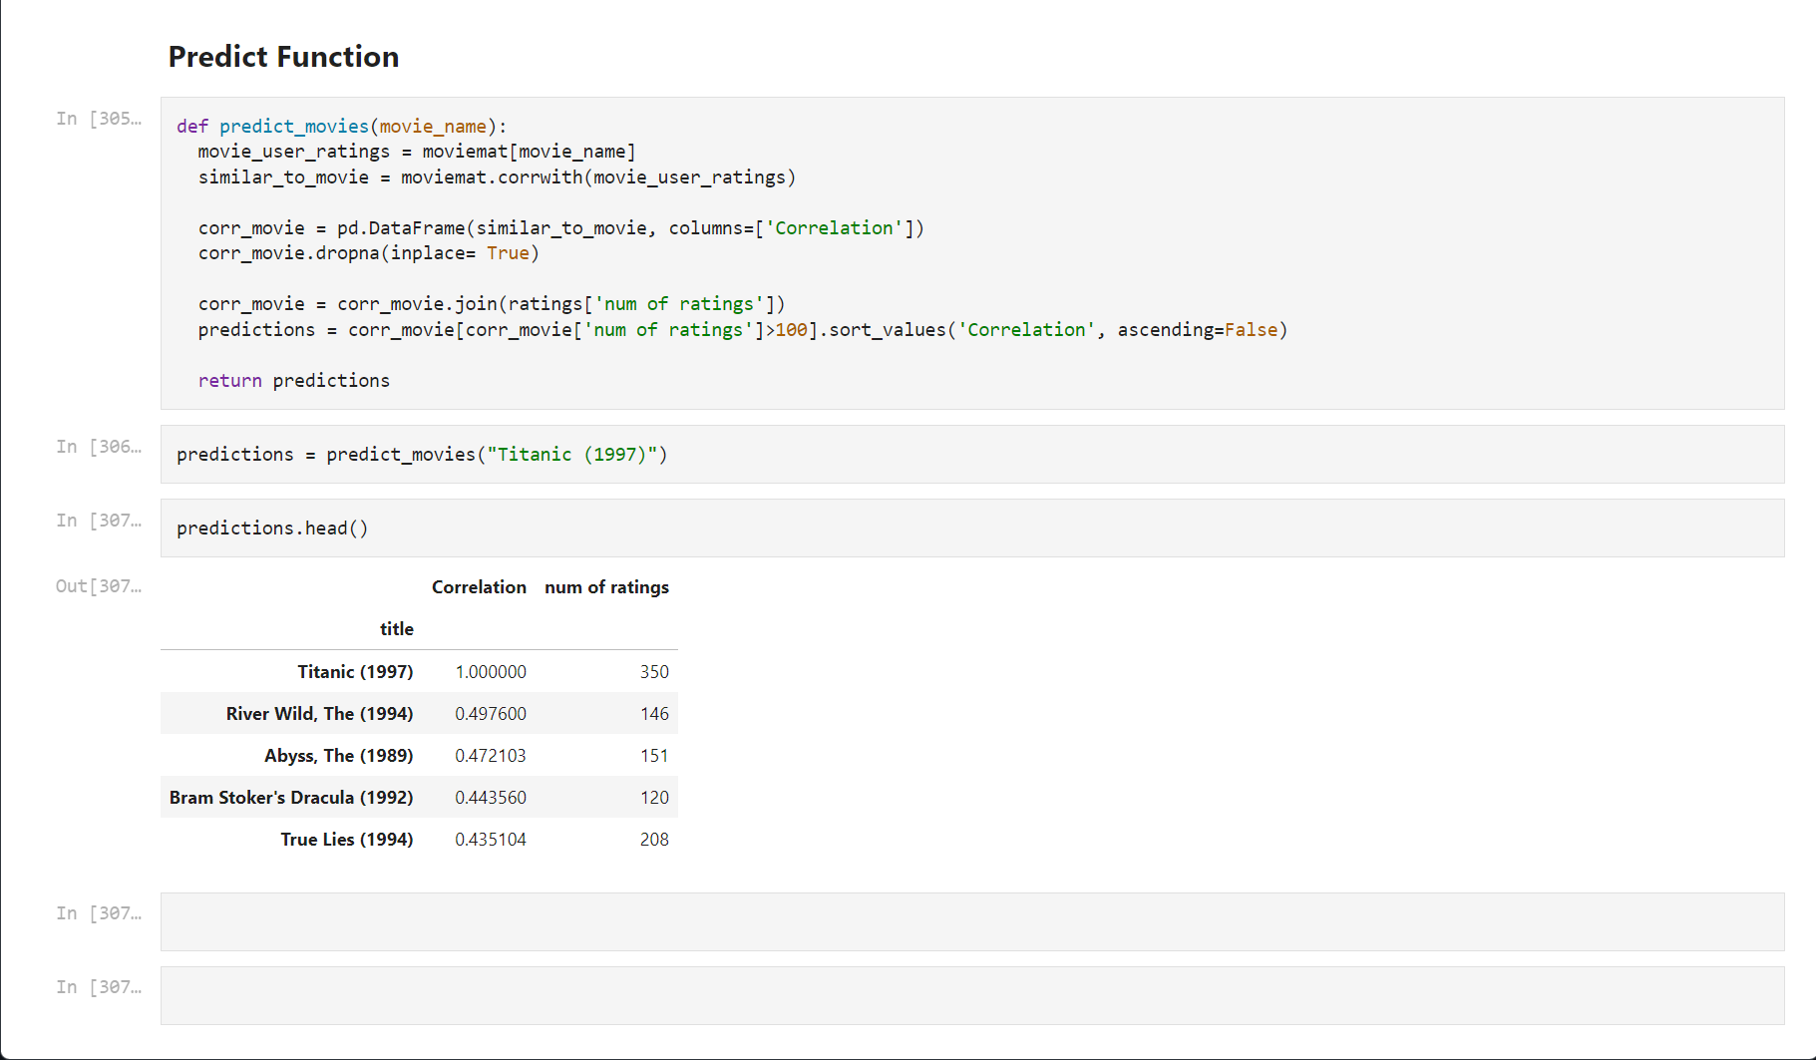

Slide 8
Thank You

